Slide 1
University of Diyala
Engineering College
Dep. of Engineering Mechanics
Class: 2th
Subject: Matematices
CHAPTER 1
The vector

Slide 2
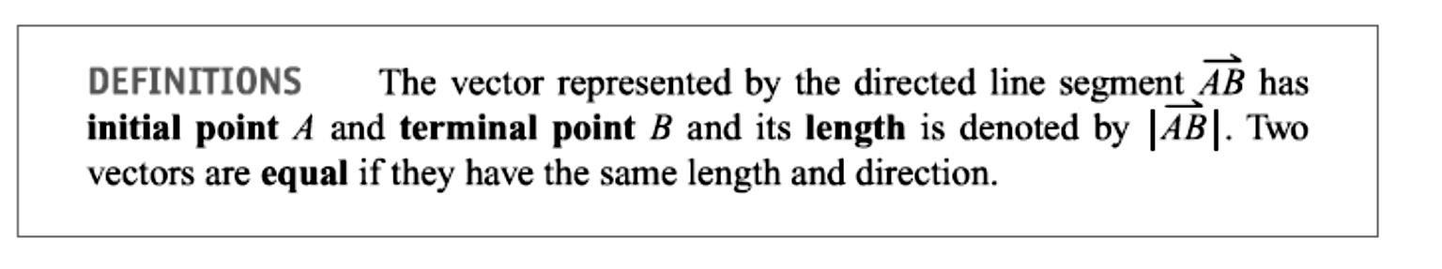
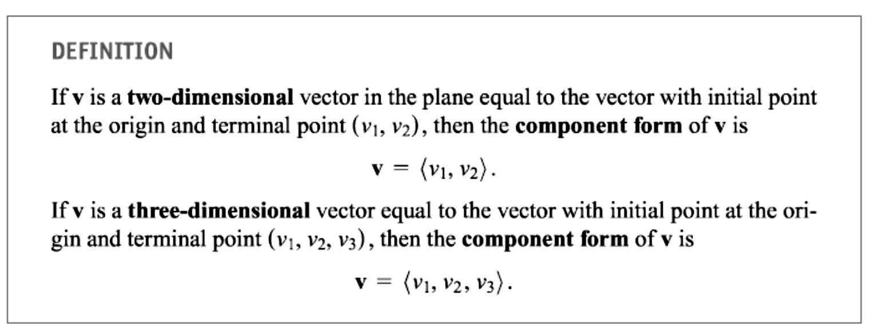
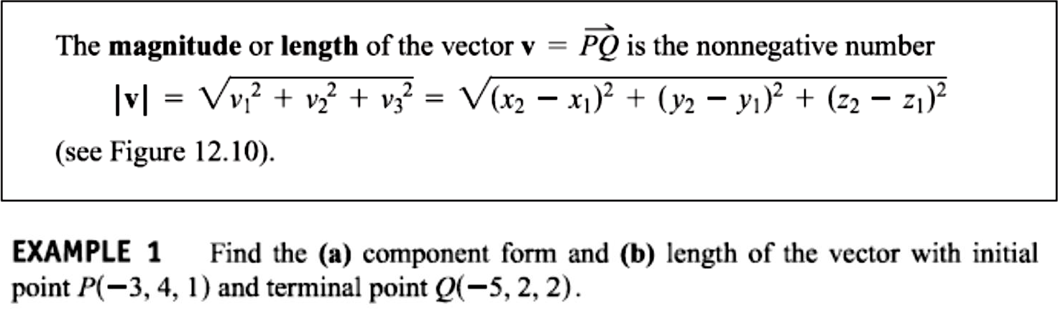
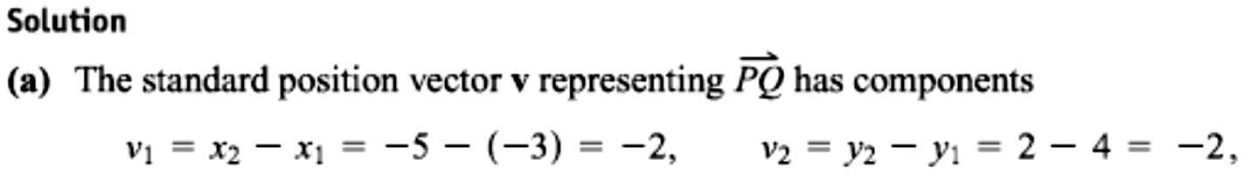
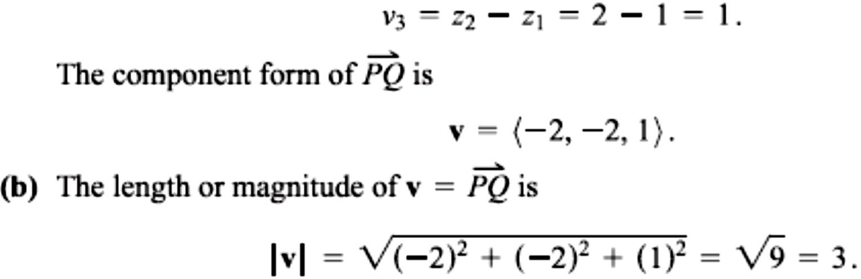
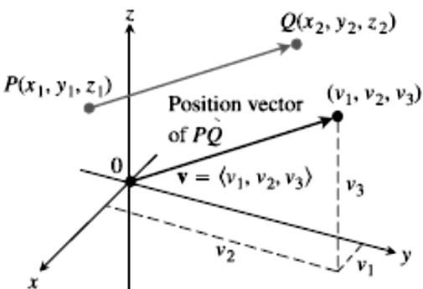
1 / Dep. Of Engineering Mechanics
Class: 2th AMTHMATICS / The vector
The Vector

Slide 3
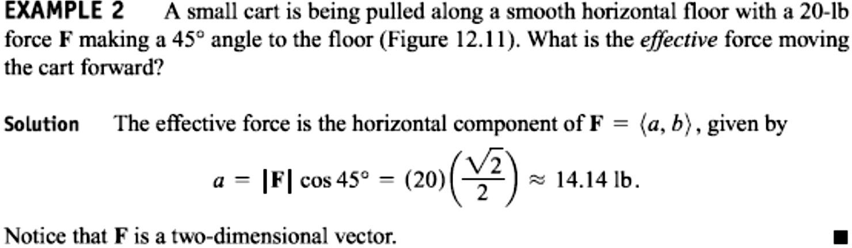
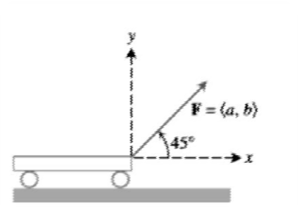
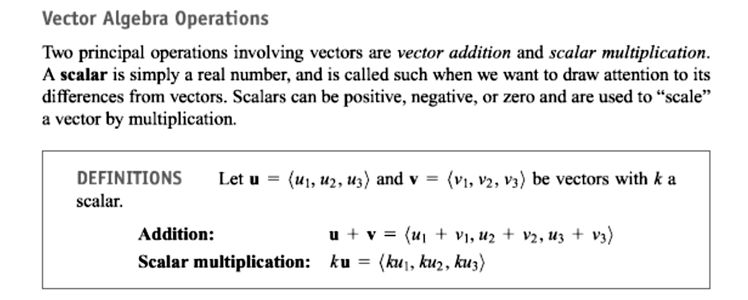

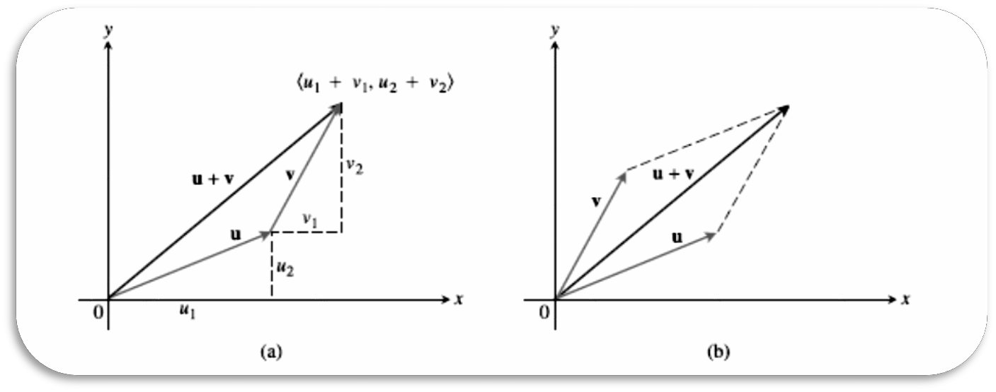
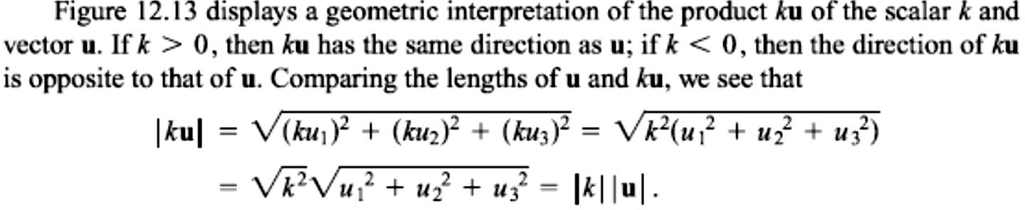
2 / Dep. Of Engineering Mechanics
Class: 2th AMTHMATICS / The vector

Slide 4
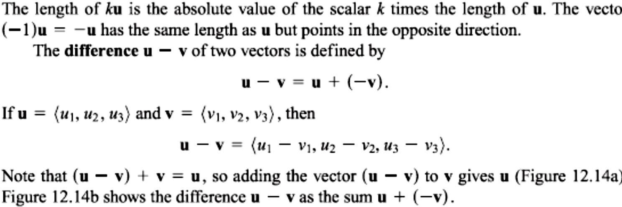
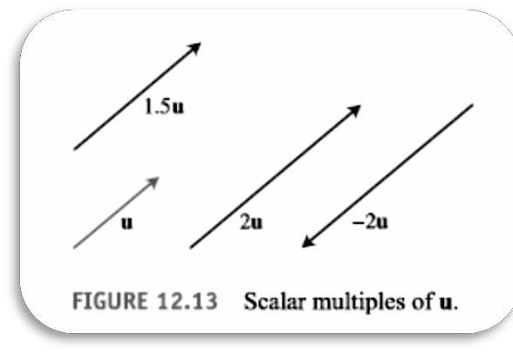
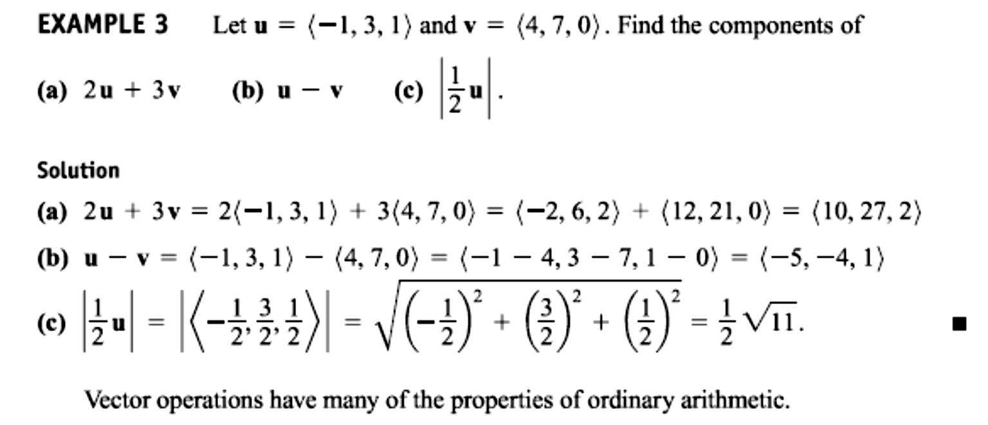
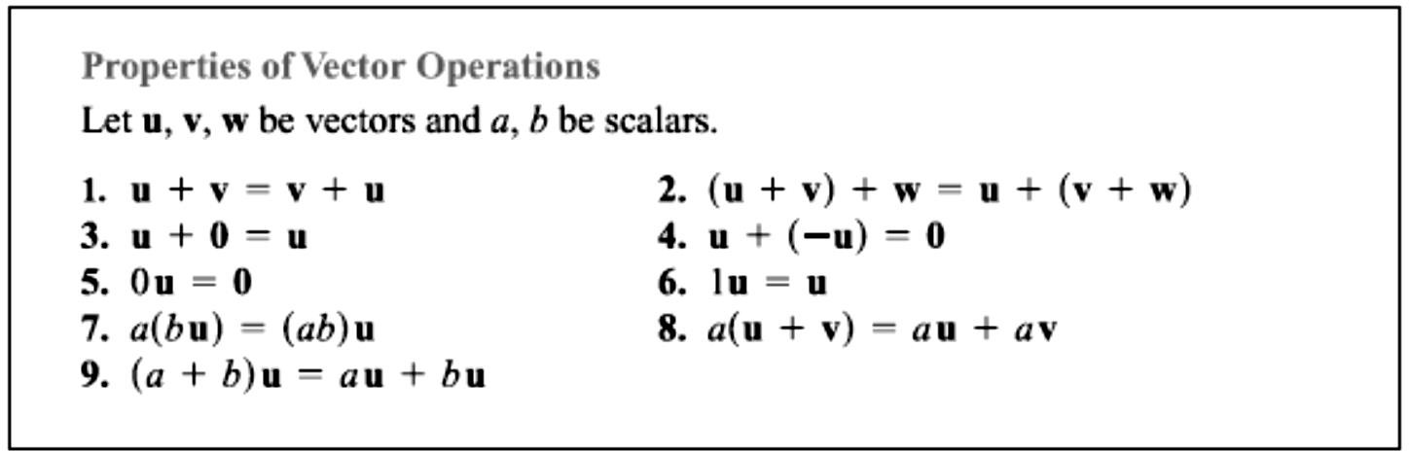
3 / Dep. Of Engineering Mechanics
Class: 2th AMTHMATICS / The vector

Slide 5
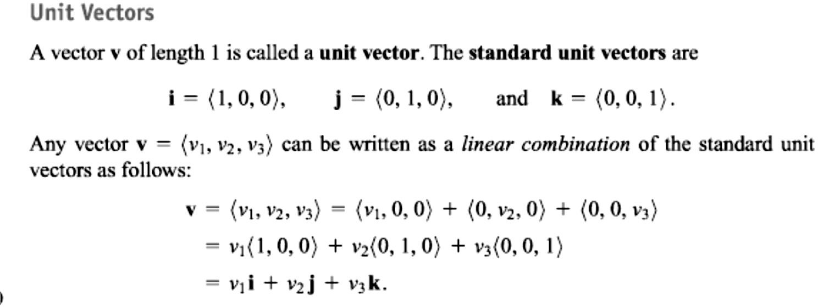
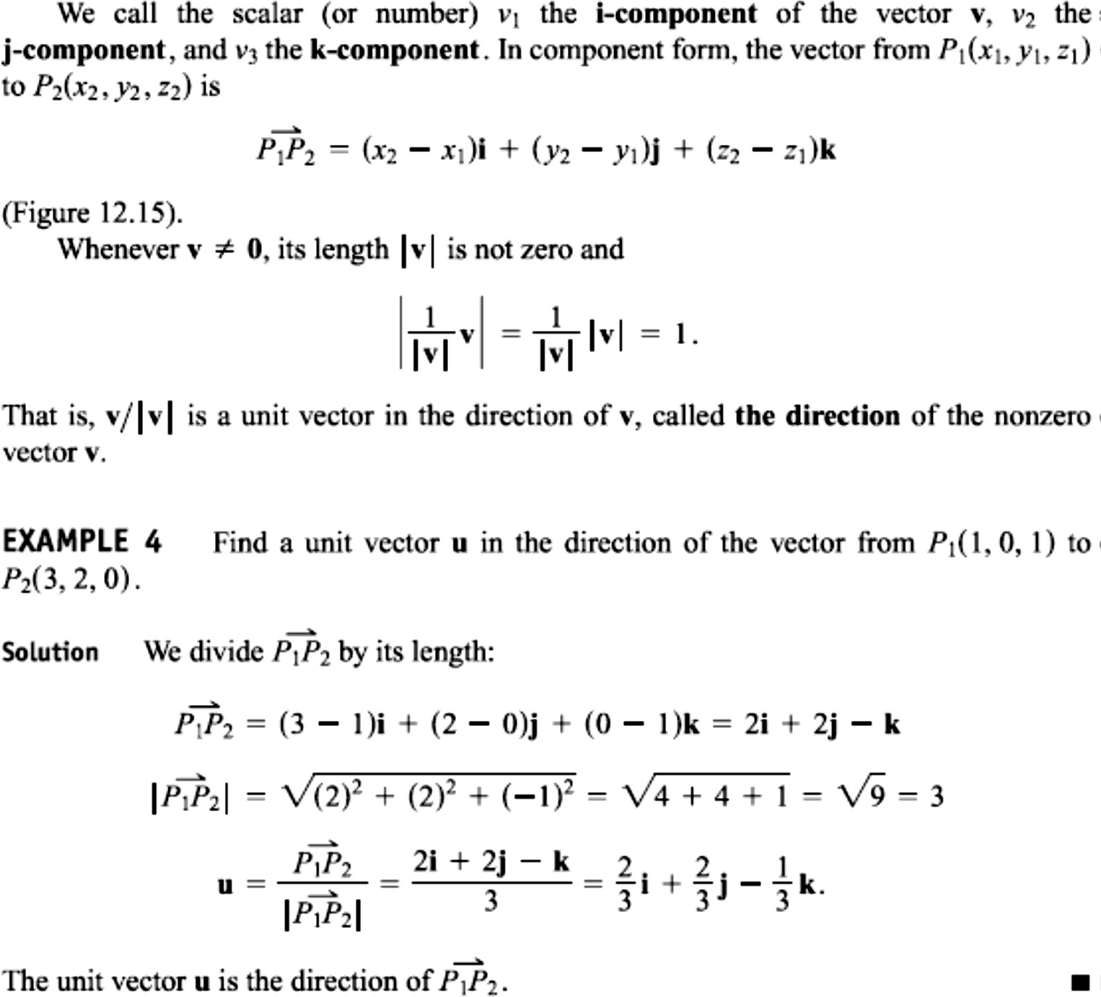
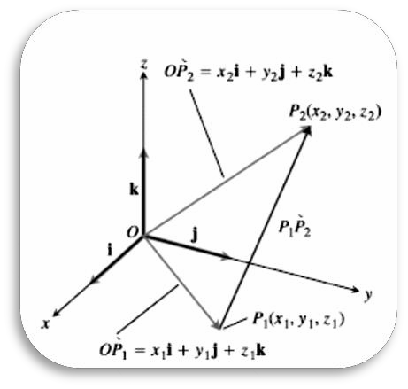
4 / Dep. Of Engineering Mechanics
Class: 2th AMTHMATICS / The vector

Slide 6
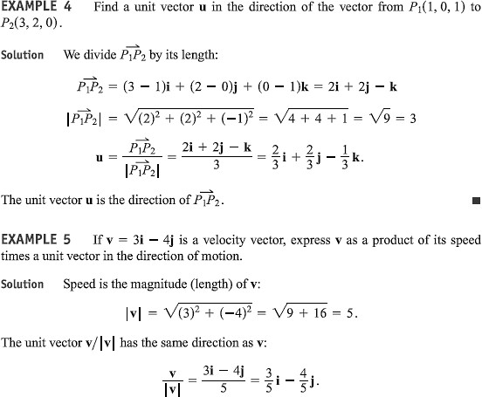
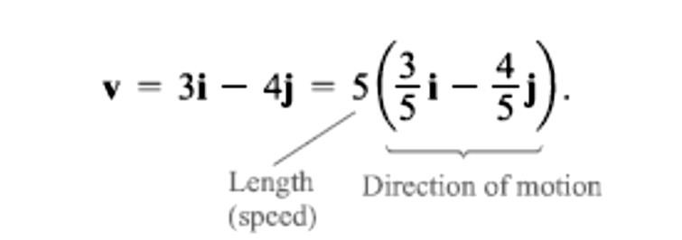
5 / Dep. Of Engineering Mechanics
Class: 2th AMTHMATICS / The vector

Slide 7
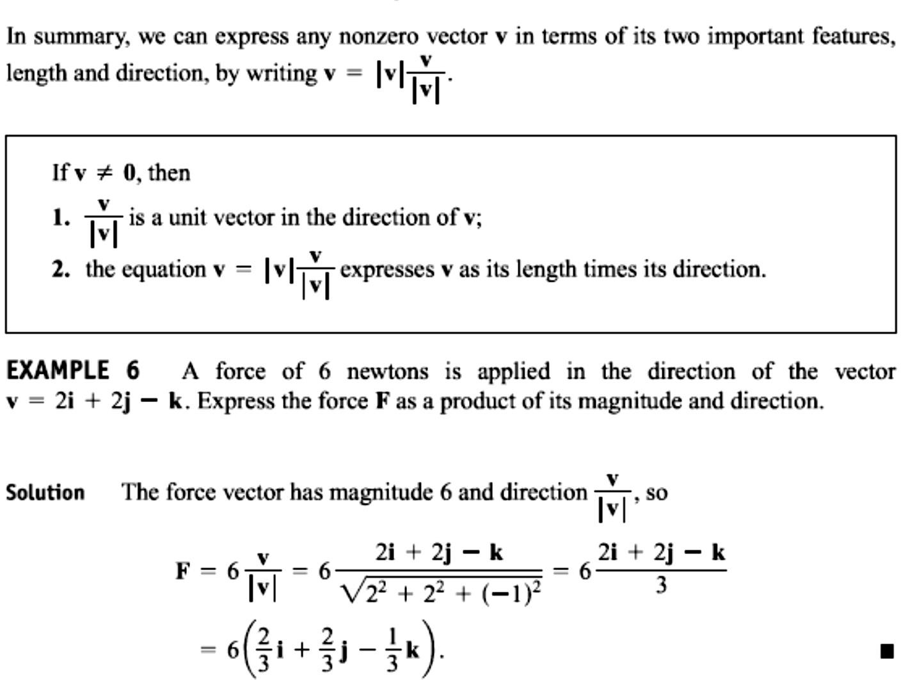
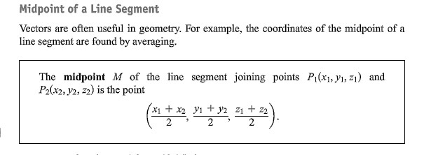
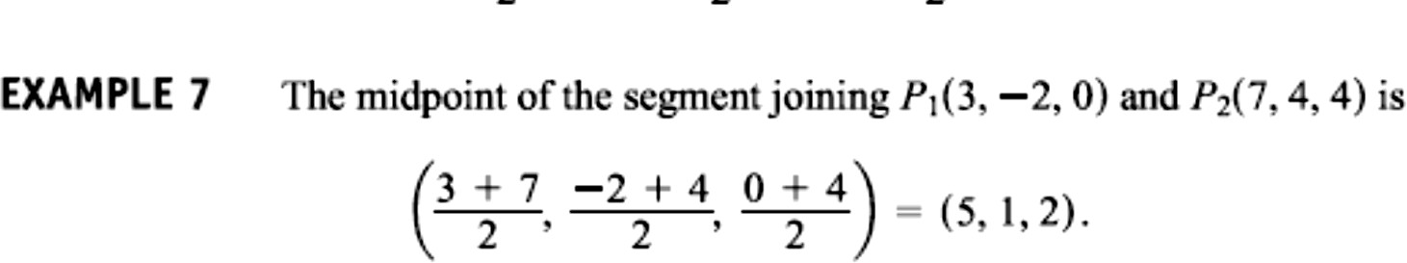
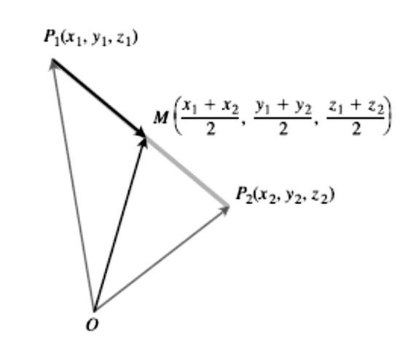
6 / Dep. Of Engineering Mechanics
Class: 2th AMTHMATICS / The vector

Slide 8
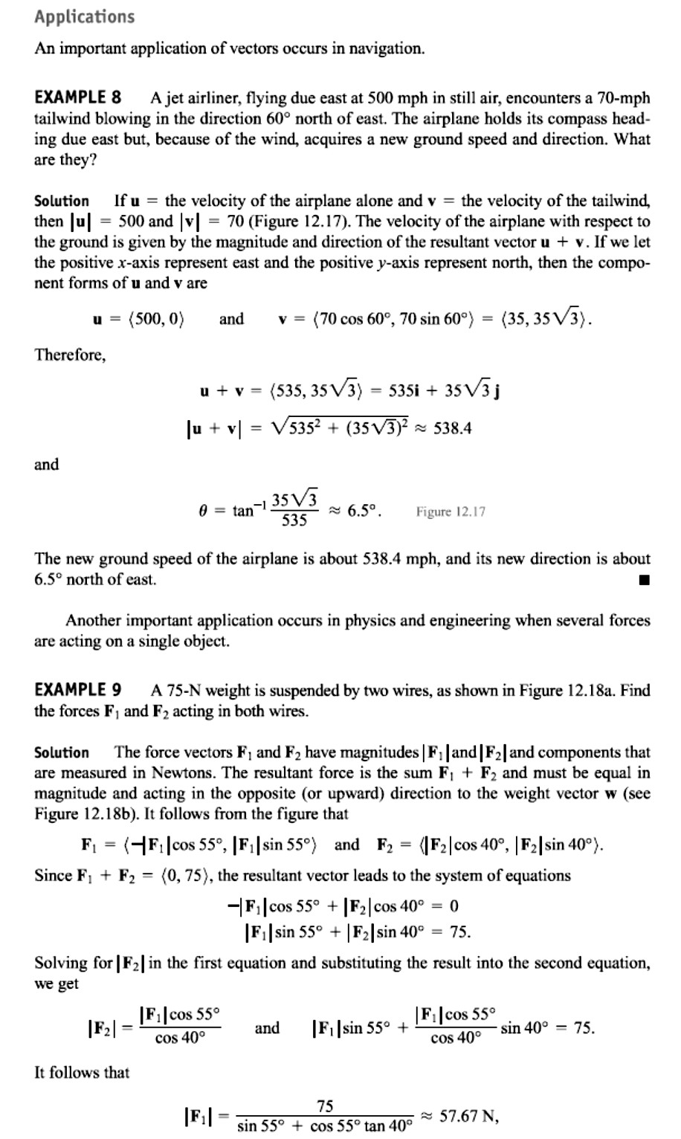
7 / Dep. Of Engineering Mechanics Class: 2th AMTHMATICS / The vector

Slide 9
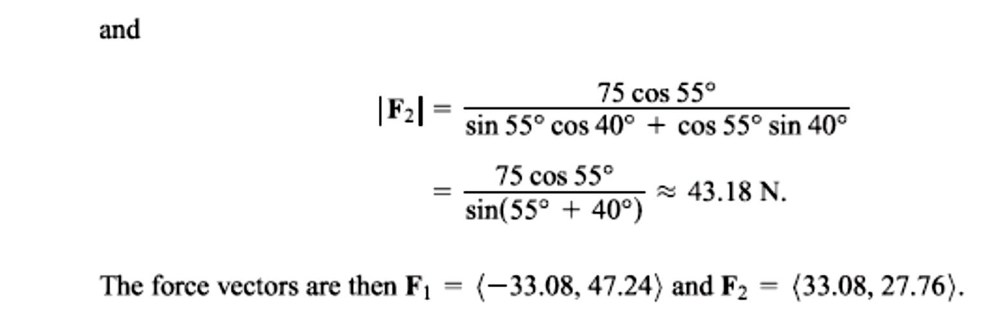
8 / Dep. Of Engineering Mechanics
Class: 2th AMTHMATICS / The vector

